Slide 1
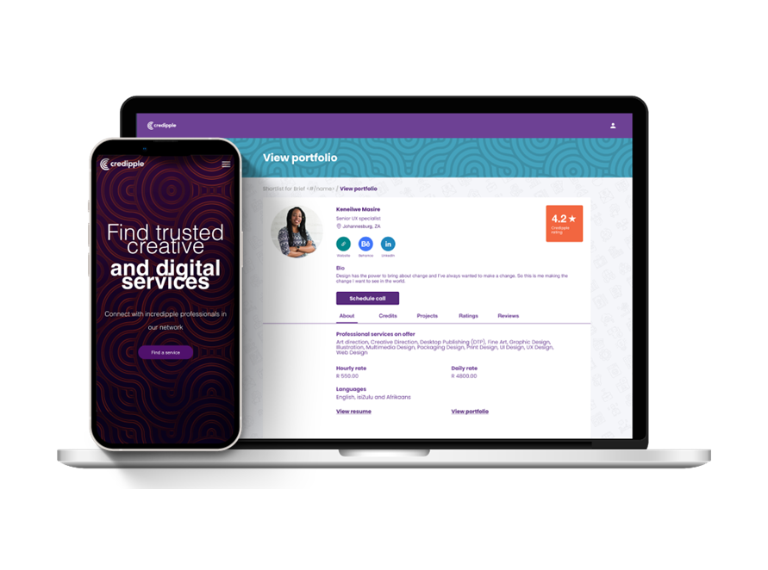


Case Study
Consumer
Key Highlights
Revenue to date
R3,3mil in FY2024
R1.5mil generated thriugh Telkom in FY2024
Job Creation
4 x permanent jobs and 2 x contractors
49 short term jobs created via Marketplace Vouchers
289 short term jobs through the marketplace with an average job value of R 25 000.00
Marketing and Business Development support
Description
Business Needs
Results
Credipple executed Pan African Hack Ur Culture Hackathon (2020) sponsored By Telkom Foundation with a focus on Preservation, Promotion and Education of African Cultural Heritage.
Marketplace Voucher Pilot in 2022 giving Futuremaker businesses like Khoi Tech access to Digital Marketing services to help grow their businesses.
Telkom approved a R500k grant and made a pre seed investment via their VC firm in 2022 to accelerate the development and growth of the Credipple Marketplace.
R3mil loan from approved Oct 2023
Credipple is a rewards-based talent marketplace connecting business clients to trusted creative and digital professionals for online and remote work.
Credipple had a strong community of creative and digital professionals and a strong business model however required seed investment to develop their marketplace platform so they could scale
Key partnerships and clients
Digify Africa
Goethe-Institut
Amazon Web Services
Deutsche Gesellschaft für Internationale Zusammenarbeit

